Slide 1

EXPLICIT CONTENT CENSOR (ECC )
- bY
HARSHIT RAI
vishWAS SINGH
VINAY VISHWAKARMA
PRATHAMESH PATADE

Slide 2
PRESENTATION OUTLINE
1: Introduction
2: Problem Definition
3: Methodology Adopted to Solve the Problem
4: Results
5: What’s Next ?
6: Future Challenges
7: Reference

Slide 3
INTRODUCTION
A survey^{[1]} conducted by BBC reveals that almost 60% of young people were 14 years old or younger when they first saw porn online.
About 62% of them said they first saw it when they weren’t expecting it.
Another survey ^{[2]} reveals that almost 88% of American Kids between 12-17 years old, who access web daily, witnessed cyberbullying.
Restricting contents helps especially in cases when children are exposed to inappropriate contents by accident.
There are various options available (like VPNs, Antivirus, etc.), but they perform poorly in getting the job done.

Slide 4

EFFECTS OF CYBER-BULLYING ON YOUTHS :
Low self-esteem
Change in Personality
(Anger, Depression, Crying, Withdrawn)
Losing Weight & Changing Appearance to try to fit in
Withdrawal from family
Spending a lot of time alone
EFFECTS OF PORNOGRAPHY ON YOUTHS :
Addiction
Sexual Frustration
Sexual Violence
Attention Deficit Disorder

Slide 5
PROBLEM DEFINITION
Existing content censoring software are basically limited to only handling backlists and blocking URLs .
Social-media websites are trying their best to censor abusive and obscene contents, but are limited to only images and videos.
The proposed solution aims to censor images ^{[3]} and videos which exist not only on the internet but also on the local storage devices.
The solution also aims to censor text ^{[4]} in order to achieve complete censoring of explicit contents irrespective of their type.

Slide 6
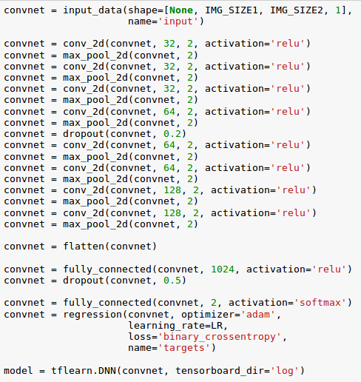
Methodology ADOPTED TO SOLVE THE PROBLEM
The proposed solution uses a Convolutional Neural Network to identify and learn different characteristics of explicit contents.
A Tensorflow model was constructed consisting of 8 2D Convolution Layers, 8 2D Max Pooling Layers, 2 Fully Connected Layers and 1 Regression Output Layer.
This model was trained on a train-dataset of 30000 images (175x150 pixels each).
The model was later tested on a test-dataset of 5000 images of different dimensions.

Slide 7
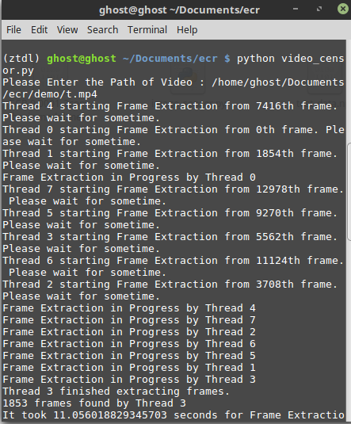
Classification of individual images was found to be instantaneous. However, this wasn’t the case with Video Processing.
To speed up the process of censoring in videos, multithreading was implemented. A total of 8 threads were created, which reduced the waiting time by a factor of 3.
A unique technique, coined as “Process Once, View Forever” was used, which allowed new videos to be processed only once and then be viewed at anytime in future.

Slide 8

RESULTS
The results mentioned below correspond to the censoring of only offline contents.
An average accuracy of 85% was achieved while classifying the test images as well as new unseen images.
The model performed similarly on videos but occasionally suffered in classification.
This clutter in performance was experienced due to lack of diversity in training dataset.
An immediate need was felt to include more images in training and testing datasets.

Slide 9
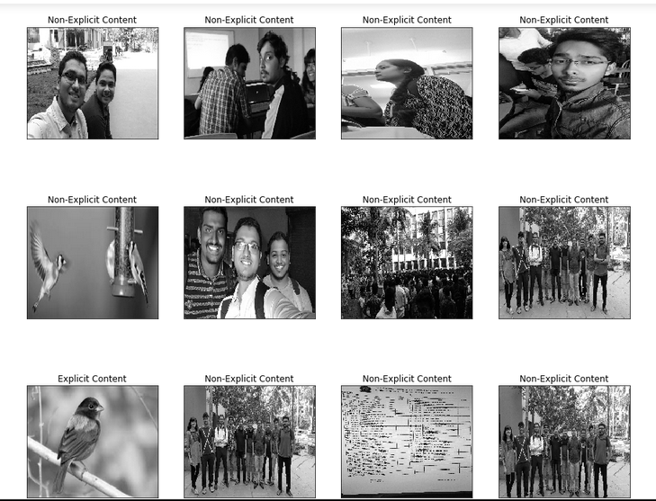

Slide 10
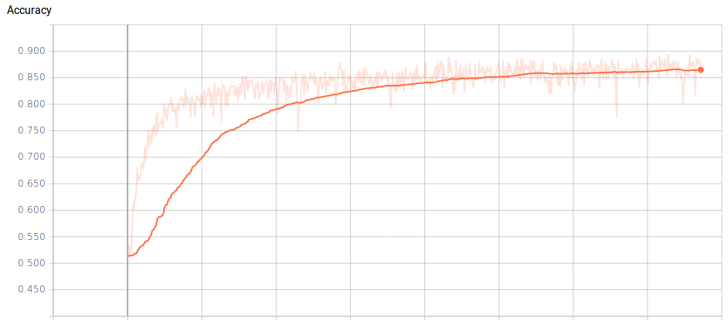

Slide 11
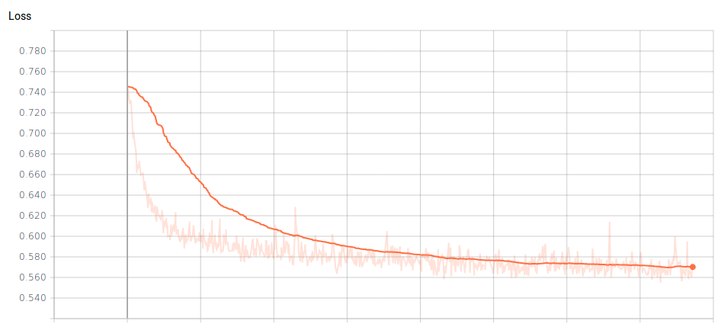

Slide 12
What's NEXT ?
ONLINE TEXT CENSORING
The ECC will be integrated with the browser with the help of an extension.
Offensive and Explicit Contents in form of text can be filtered using Convolutional Neural Networks with Word Embedding.
Explicit text will be removed from the Web Pages by accessing and modifying the contents of DOM (Document Object Model).

Slide 13
FUTURE CHALLENGES
ONLINE IMAGE & VIDEO CENSORING IN REAL-TIME
How do we censor images in browser in real-time without affecting the UX ?
How do we censor videos in browser in real-time after considering the fact that online videos are buffered as a continuous stream of data ?

Slide 14
REFERENCE
[1] : BBC Three Survey - Porn: What’s The Harm? Retrieved from :
http://www.bbc.co.uk/mediacentre/latestnews/2014/porn-whats-the-harm
[2] : “Cyberbullying". Gale Student Resources in Context. 2016
– via Gale, Cengage Learning.
[3] : Deepika Jaiswal and Sowmya Sonam “Image Classification Using Convolutional Neural Networks”
from International Journal of Advancement in Research & Technology, Volume 3, Issue-6, June 2014
[4] : Theodora Chu, Kylie Jue and Max Wang. “Comment Abuse Classification with Deep
Learning” Retrieved from https://web.stanford.edu/class/cs224n/reports/2762092.pdf

Slide 15
THANK YOU

